Slide 1
Jack(A Virtual Assistant)
AI Voice Assistant

Slide 2
TEAM MEMBERS
D. Bhagavan
Anjali
Vennela
Naresh
Raju

Slide 3
Abstract
This is the era of Artificial Intelligence. In this period intelligent toys were born.
They are started learning, reacting according to the situation and understanding human emotions.
As we know Python is an emerging language so it becomes easy to write a script for VoiceAssistant in Python.
The instructions for the assistant can be handled as per the requirementof user.
Speech recognition is the process of converting speech into text. This is commonly used in voice assistants like Alexa, Siri, etc.
By using Natural Language Processing algorithm helps computer machines to engage in communication using natural human language in many forms.

Slide 4
Introduction
Today the development of artificial intelligence (AI) systems that can organize a natural human-machine interaction (through voice, communication, gestures, facial expressions, etc.) are gaining in popularity.
Virtual assistants are software programs that help you ease your day to day tasks, such as showing weather reports, creating remainders, making shopping lists etc.
They can take commands via text (online chatbots) or by voice.
Voice-based intelligent assistants need an invoking word or wake word to activate the listener, followed by the command.
We have so many virtual assistants, such as Apple’s Siri, Amazon’s Alexa and Microsoft’s Cortana.

Slide 5
ConTd…..
This system is designed to be used efficiently by voice commands.
Personal assistants software improves user productivity by managing routine tasks of the user and by providing information from an online source to the user.

Slide 6
Types of AI Virtual Assistants
There are several different types of AI virtual assistants:
Chatbots,
Voice assistants,
AI avatars,
Domain-specific virtual assistants

Slide 7
Existing System
There are some existing systems from which the idea of creating an application of chatbot (virtual personal assistant) was inspired.
They are Alexa, Siri, Google Assistant, Microsoft Cortana etc.
They have limited features to explore
New features may to Those Virtual Assistants

Slide 8
Proposed system
We have made a AI Virtual Assistant that will change the way you look at them.
Our Virtual Assistant had more features than existing systems!
FEATURES OF OUR JACK(A VIRTUAL ASSISTANT)
Greetings
Opens the YouTube
Opens the Google
Search in Wikipedia

Slide 9
Problem statement
It can’t communicate personalization like a human!
It has limited features to explore with Voice Commands!
Lack of accuracy and personalization.
When a VA is not able to answer questions accurately, it’s because it lacks the proper context or doesn’t understand the intent of the question.
Adding Emotions to the virtual Assistant is a very different task!!

Slide 10
Program code
import pyttsx3 #pip install pyttsx3
import speech_recognition as sr #pip install speechRecognition
import datetime
import wikipedia #pip install wikipedia
import webbrowser
import os
import smtplib
engine = pyttsx3.init('sapi5')
voices = engine.getProperty('voices')
# print(voices[1].id)
engine.setProperty('voice', voices[0].id)

Slide 11
Contd….
def speak(audio):
engine.say(audio)
engine.runAndWait()
def wishMe():
hour = int(datetime.datetime.now().hour)
if hour>=0 and hour<12:
speak("Good Morning!")
elif hour>=12 and hour<18:
speak("Good Afternoon!")
else:
speak("Good Evening!")
speak("I am Jarvis Sir. Please tell me how may I help you")

Slide 12
Contd……
def takeCommand():
#It takes microphone input from the user and returns string output
r = sr.Recognizer()
with sr.Microphone() as source:
print("Listening...")
r.pause_threshold = 1
audio = r.listen(source)
try:
print("Recognizing...")
query = r.recognize_google(audio, language='en-in')
print(f"User said: {query}\n")

Slide 13
Contd…….
except Exception as e:
# print(e)
print("Say that again please...")
return "None"
return query
def sendEmail(to, content):
server = smtplib.SMTP('smtp.gmail.com', 587)
server.ehlo()
server.starttls()
server.login('bhagavandheeravath0@gmail.com', 'Bhaggu@01')
server.sendmail('bhagavandheeravath4@gmail.com', to, content)
server.close()

Slide 14
Contd…….
if __name__ == "__main__":
wishMe()
while True:
# if 1:
query = takeCommand().lower()
# Logic for executing tasks based on query
if 'wikipedia' in query:
speak('Searching Wikipedia...')
query = query.replace("wikipedia", "")
results = wikipedia.summary(query, sentences=2)
speak("According to Wikipedia")
print(results)
speak(results)

Slide 15
Contd……
elif 'open youtube' in query:
webbrowser.open("youtube.com")
elif 'open google' in query:
webbrowser.open("google.com")
elif 'open stackoverflow' in query:
webbrowser.open("stackoverflow.com")
elif 'play music' in query:
music_dir = 'D:\music'
songs = os.listdir(music_dir)
print(songs)
os.startfile(os.path.join(music_dir, songs[0]))

Slide 16
Contd………
elif 'the time' in query:
strTime = datetime.datetime.now().strftime("%H:%M:%S")
speak(f"Sir, the time is {strTime}")
elif 'open code' in query:
codePath = "Code.exe"
os.startfile(codePath)
elif 'email to harry' in query:
try:
speak("What should I say?")
content = takeCommand()
to = "dheeravathbhagavan4@gmail.com"
sendEmail(to, content)
speak("Email has been sent!")
except Exception as e:
print(e)
speak("Sorry my friend harry bhai. I am not able to send this email")

Slide 17
conclusion
We are working on the code and adding extra features to the Jack(A Virtual Assisstant)

Slide 18
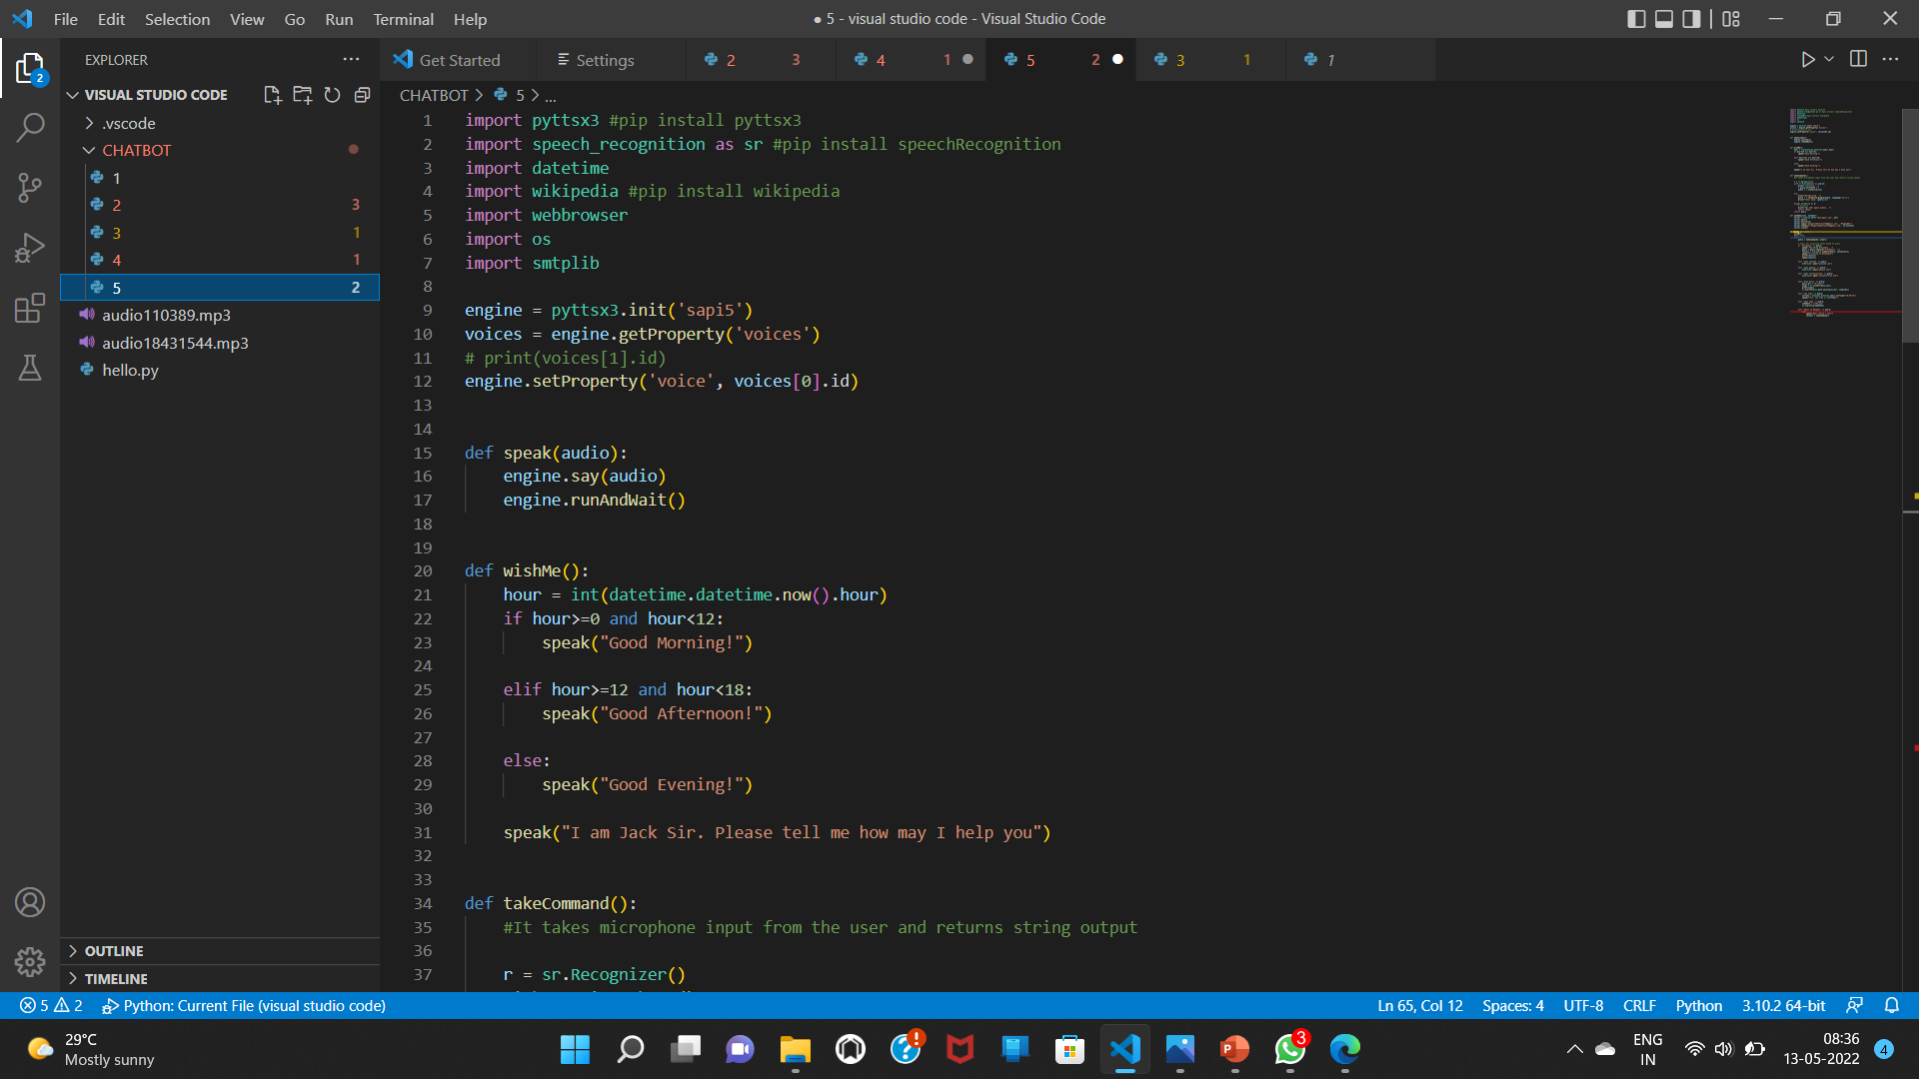
Input of the program

Slide 19
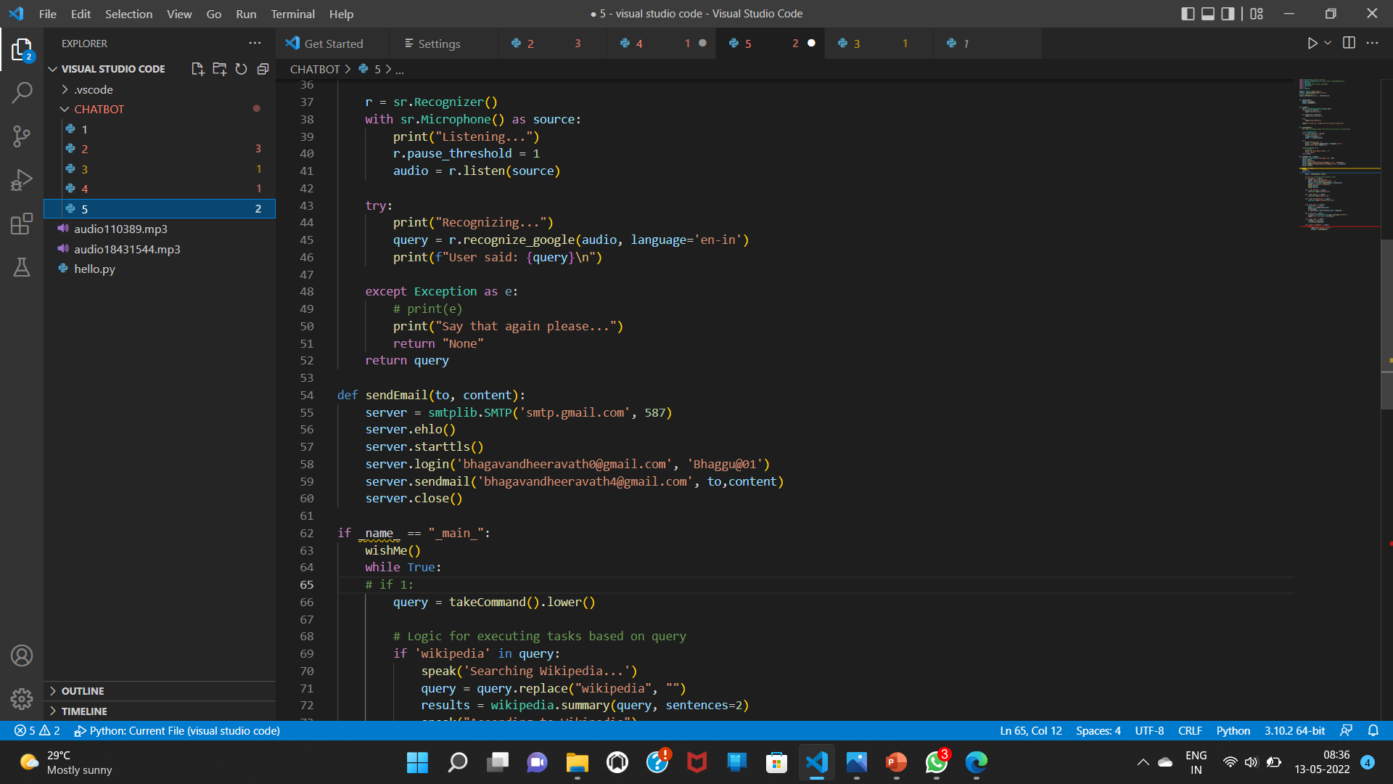
Contd…..

Slide 20
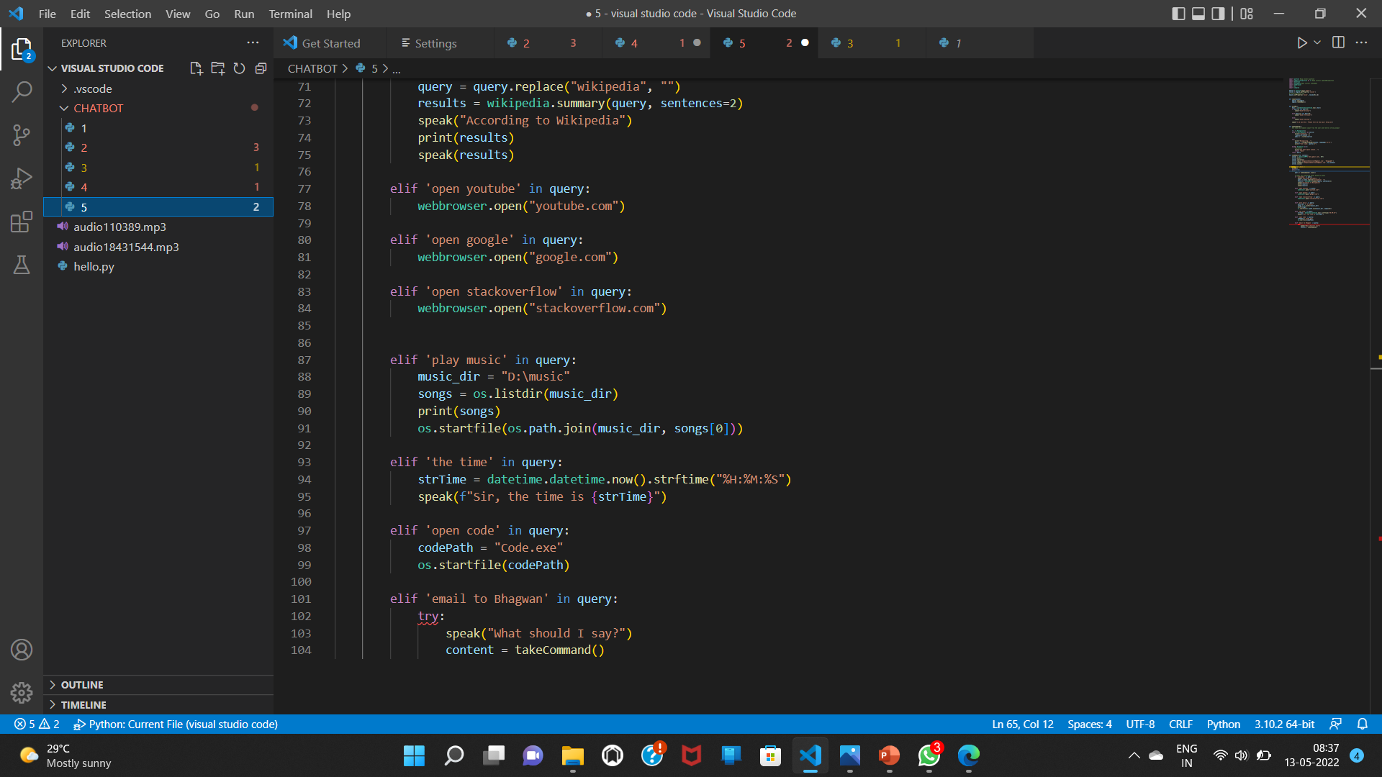
Contd…

Slide 21
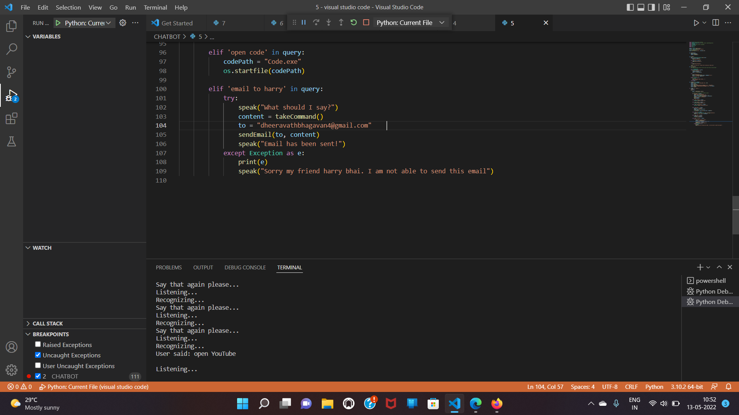
OUTPUT

Slide 22
THANK YOU

